Slide 1
The Hit Movie Formula: Data, Story, and Audience Appeal
UBC Summer Program
Group 6: Sun, Janice, Jerry, Elvis

Slide 2

Table of contents
Our Hit Movie Storyline
Key Elements of a Hit Movie
Data Analysis: Methods and Results

Slide 3
The Story Begins!
Introducing our original hit series concept

Slide 5
Key Elements of a Hit Show
Exploring the essential elements behind a successful series.

Slide 6
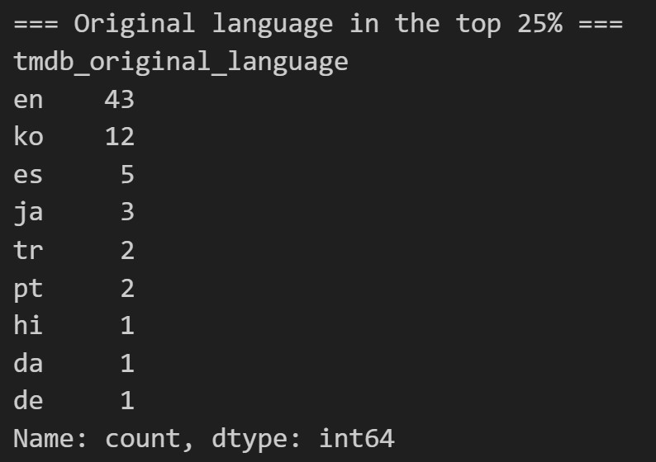
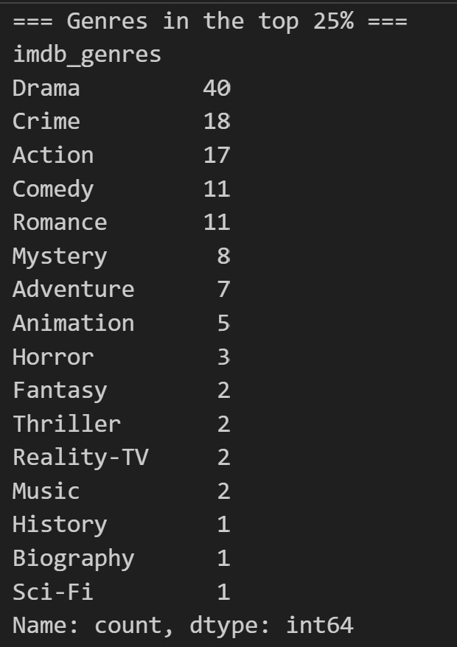
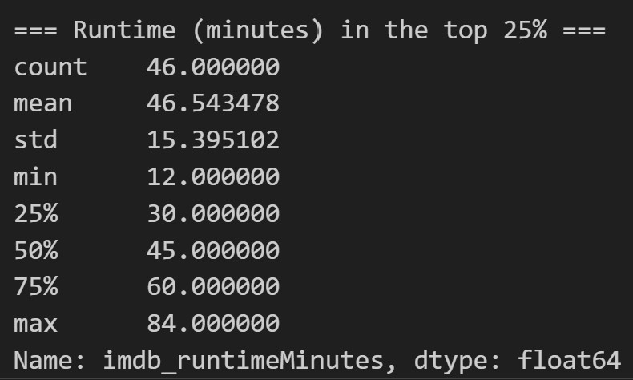
What are the awards?

Slide 7
Data Analysis
Turning series data into meaningful insights.

Slide 8



Data Sources
Netflix
IMDb
TMDB
Viewing Behavior
Audience Evaluation
Public Popularity

Slide 9
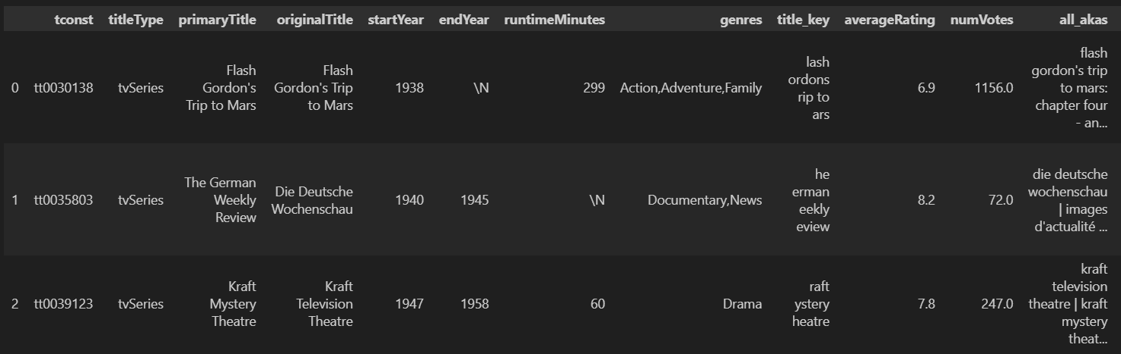
Netflix Dataset
The Netflix dataset measures how much and how long audiences actually watched each title.

Slide 10
Analysis pipeline
Merging the Three Datasets
Check Matching Coverage
Define “Hit” Titles
Analyze Correlations
Choose Features
Build the Hit Score

Slide 11

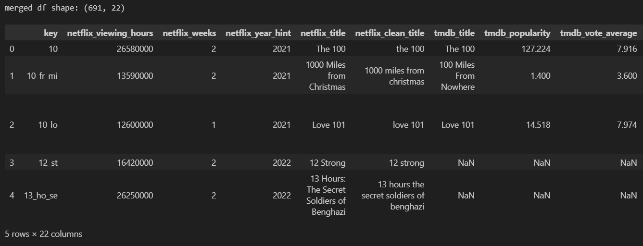
Merging the Three Datasets
We used the Netflix dataset as the main table and added selected variables from IMDb and TMDb
Removed records without title information
Removed duplicated titles
Renamed columns to identify their sources
Used left joins to preserve all Netflix titles

Slide 12
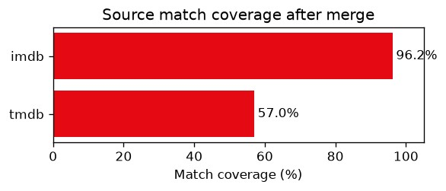
Match Coverage
Not every Netflix title could be matched with both external databases.
IMDb provided nearly complete coverage, while TMDb information was available for slightly more than half of the Netflix titles.

Slide 13
Define “Hit” Series
In Netflix viewing hours, IMDb number of votes, TMDb popularity
At least two of the three indicators were above the 75th percentile.
Hit series: 90 / Non-hit Series: 601

Slide 14
Validating the Hit Definition
In Netflix viewing hours, IMDb number of votes, TMDb popularity
At least two of the three indicators were above the 75th percentile.
Classification | Number of Titles
Hit | 90
Non-Hit | 601

Slide 15
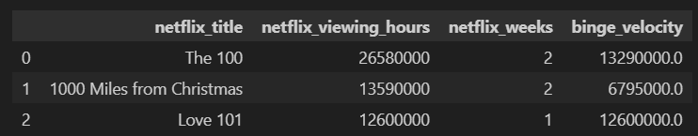
Binge Velocity
Total viewing hours may favor titles that stayed in the Netflix Top 10 for many weeks. To measure how quickly audiences watched a title, we calculated:
A higher binge velocity means that a title accumulated viewing hours more quickly.

Slide 16
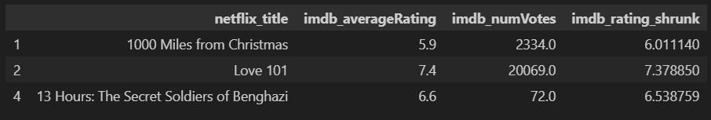
Bayesian Adjusted Rating
A high IMDb rating may not be reliable when it is based on only a small number of votes.
We used Bayesian adjustment to pull ratings with small samples toward the overall average.
Ratings with many votes remain almost unchanged,
while ratings with few votes become more conservative.

Slide 17
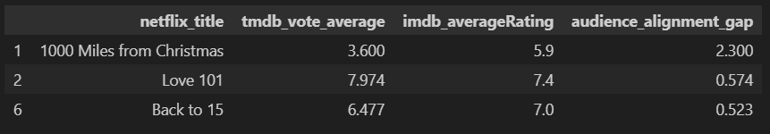
Cross-Platform Rating Gap
We measured the absolute difference between IMDb and TMDb audience ratings.
A small gap means audience opinions are consistent across platforms.
A large gap means the title receives more mixed or inconsistent evaluations.

Slide 18
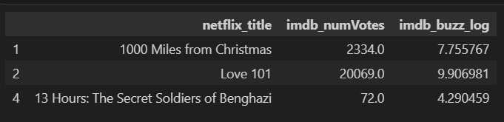
Audience Buzz
IMDb vote count reflects how many users interacted with or discussed a title.
However, vote counts were highly skewed:
a few titles had extremely large numbers of votes.
Log transformation reduces the influence of extreme values while preserving the ranking of audience attention.

Slide 19
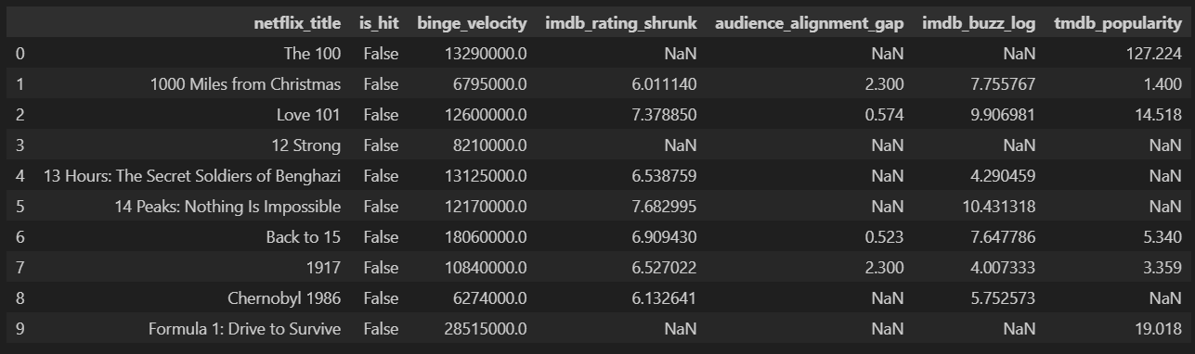
Feature Matrix
Combined the hit label and all engineered features into one analysis table.

Slide 20
Correlation Results
Binge velocity was the strongest positive indicator.
Popular titles were more likely to be classified as hits.
Reliable audience ratings had a moderate positive relationship.
Greater audience attention was associated with success.
A larger rating gap was negatively related to hit status.
Feature | Correlation with Hit Status
Binge velocity | +0.494
TMDb popularity | +0.312
Adjusted IMDb rating | +0.296
Cross-platform rating gap | −0.288
Audience buzz | +0.278

Slide 21
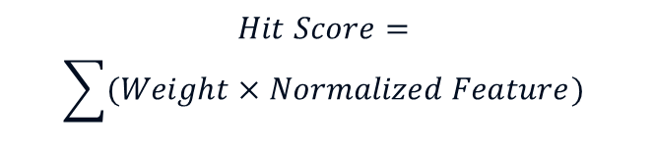
Hit Score
1. Normalize the Features
$$Normalized Value=\frac{x − x_{min}}{x_{max}−x_{min}}$$
2. Apply Feature Weights
$$Hit Score=$$
$$\sum{(Weight×Normalized Feature)}$$
Feature | Weight
Binge velocity | +0.51
TMDb popularity | +0.31
Adjusted IMDb rating | +0.23
Cross-platform rating gap | −0.23
Audience buzz | +0.22

Slide 22
Thank
You

